Slide 1


Happy Easter! From:

Slide 2

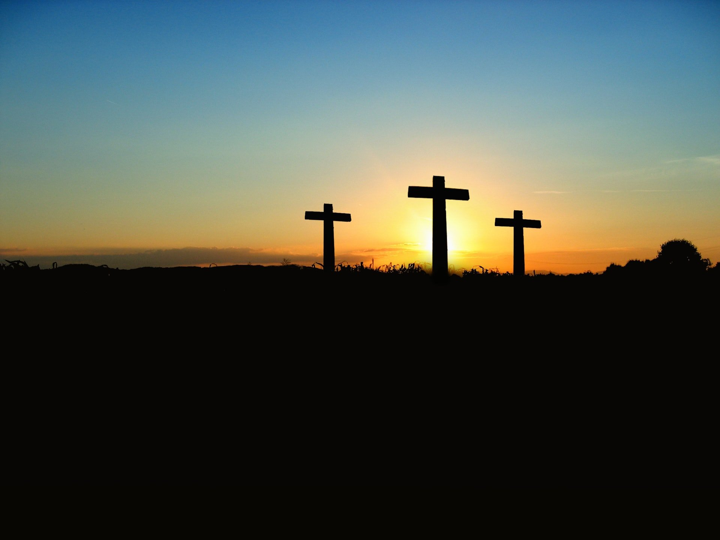

Then spake Jesus again unto them, saying, I am the light of the world: he that followeth me shall not walk in darkness, but shall have the light of life. John 8:12
Happy Easter

Slide 3

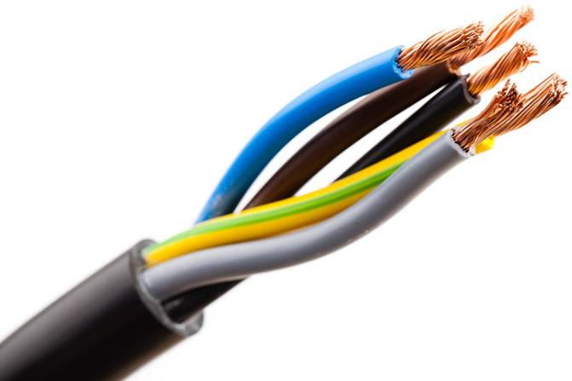


Electricians must strip to make ends meet
This Photo by Unknown Author is licensed under CC BY-SA
Happy Tax Day
This Photo by Unknown Author is licensed under CC BY-SA

Slide 4
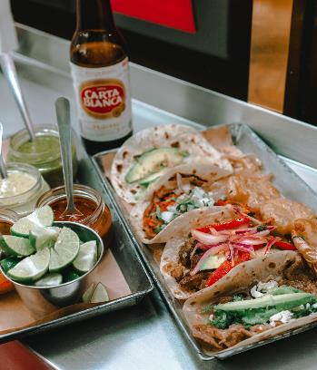

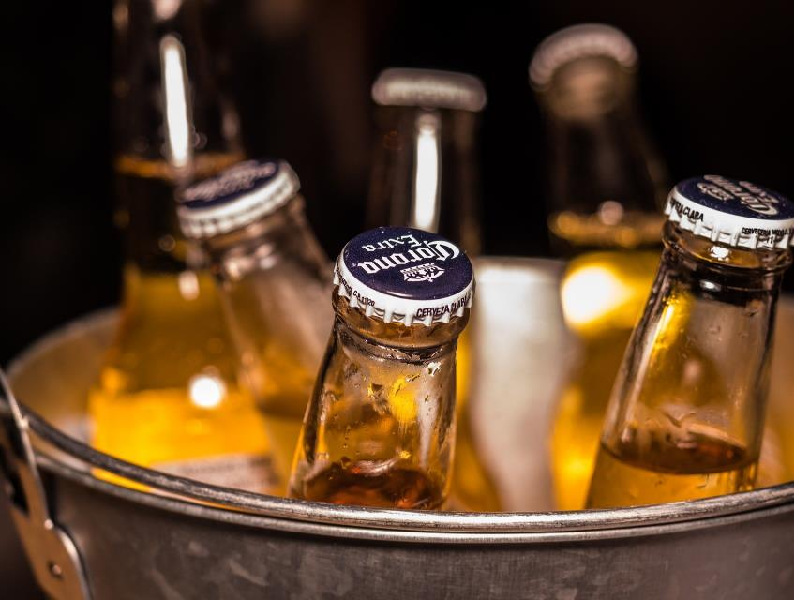

Happy Cinco de Mayo
Enjoy the beer , not the virus

Slide 5
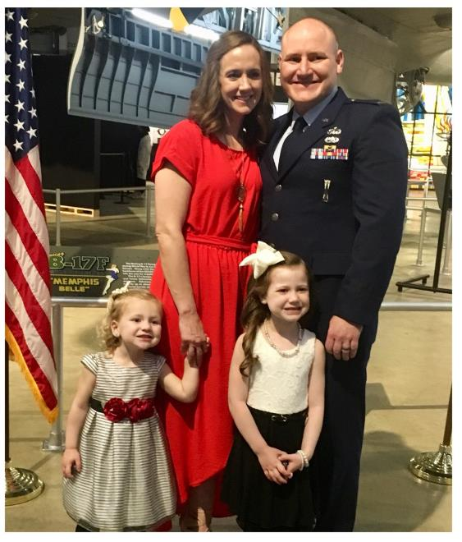


Thank you to all those who serve at home
In honor of Military Spouse’s Day
Notes:
May 8

Slide 6

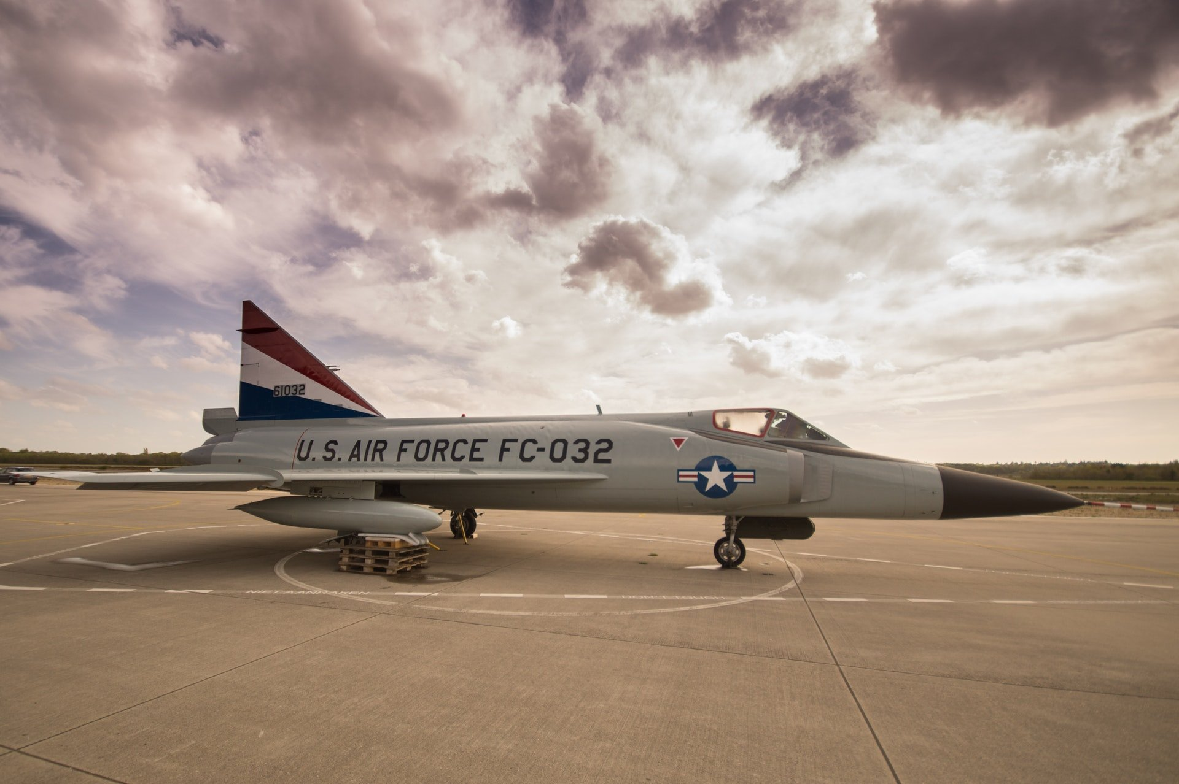
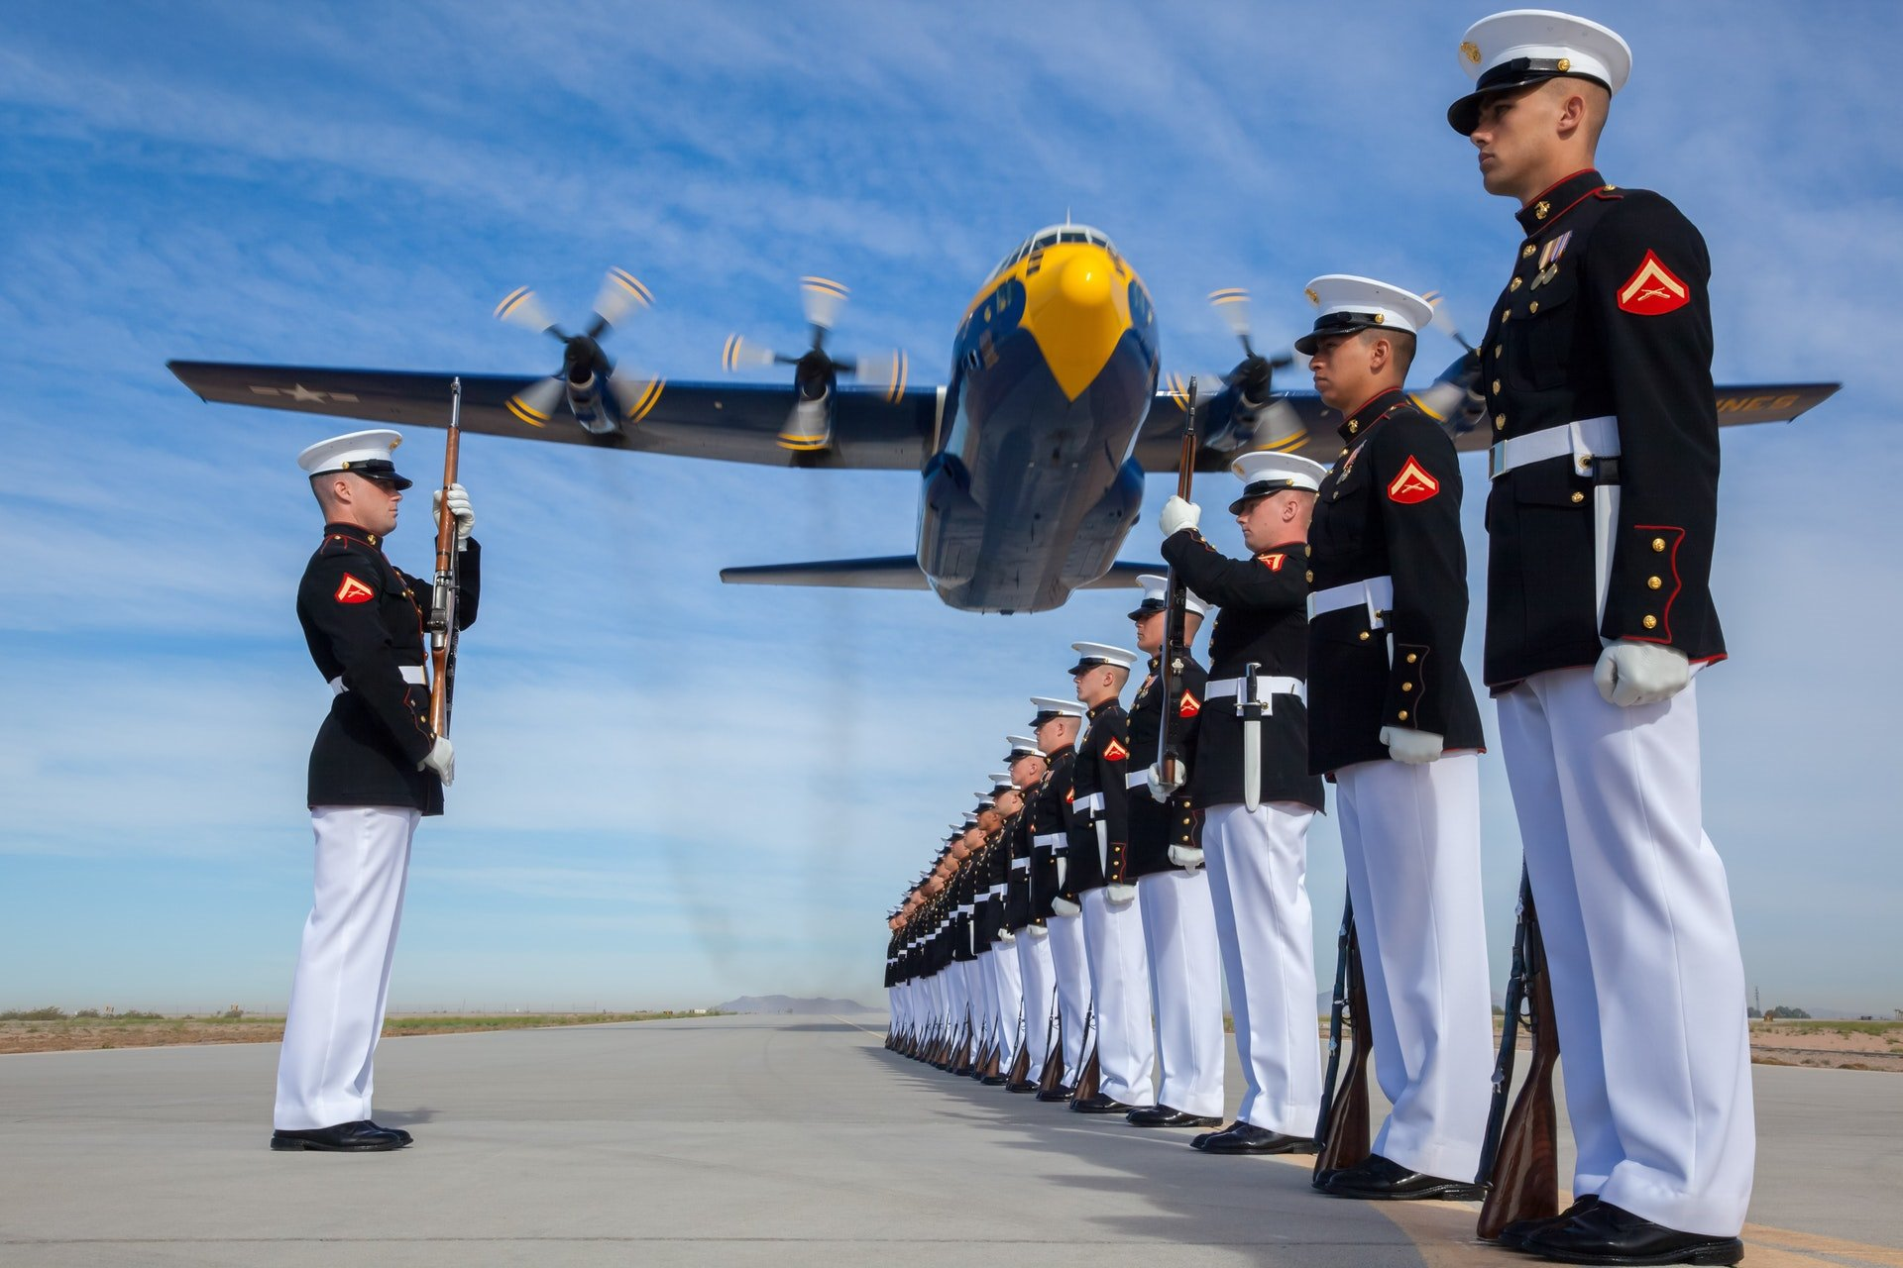

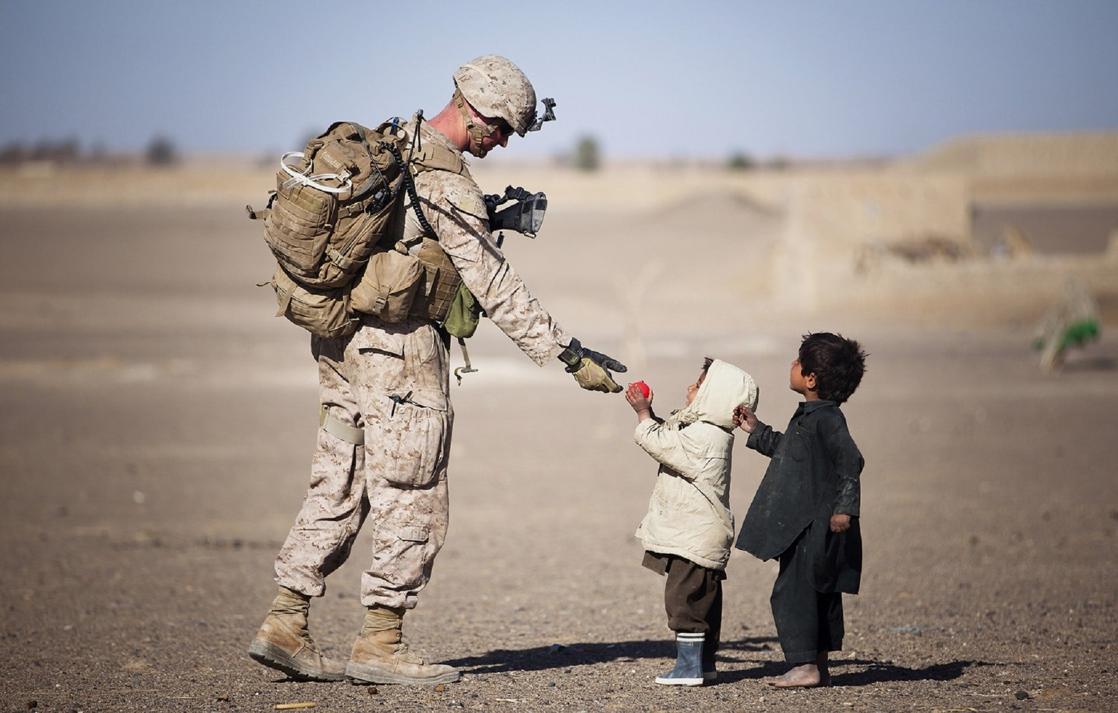
Happy Veteran's’ Day to all those who serve
Notes:
May 16

Slide 7
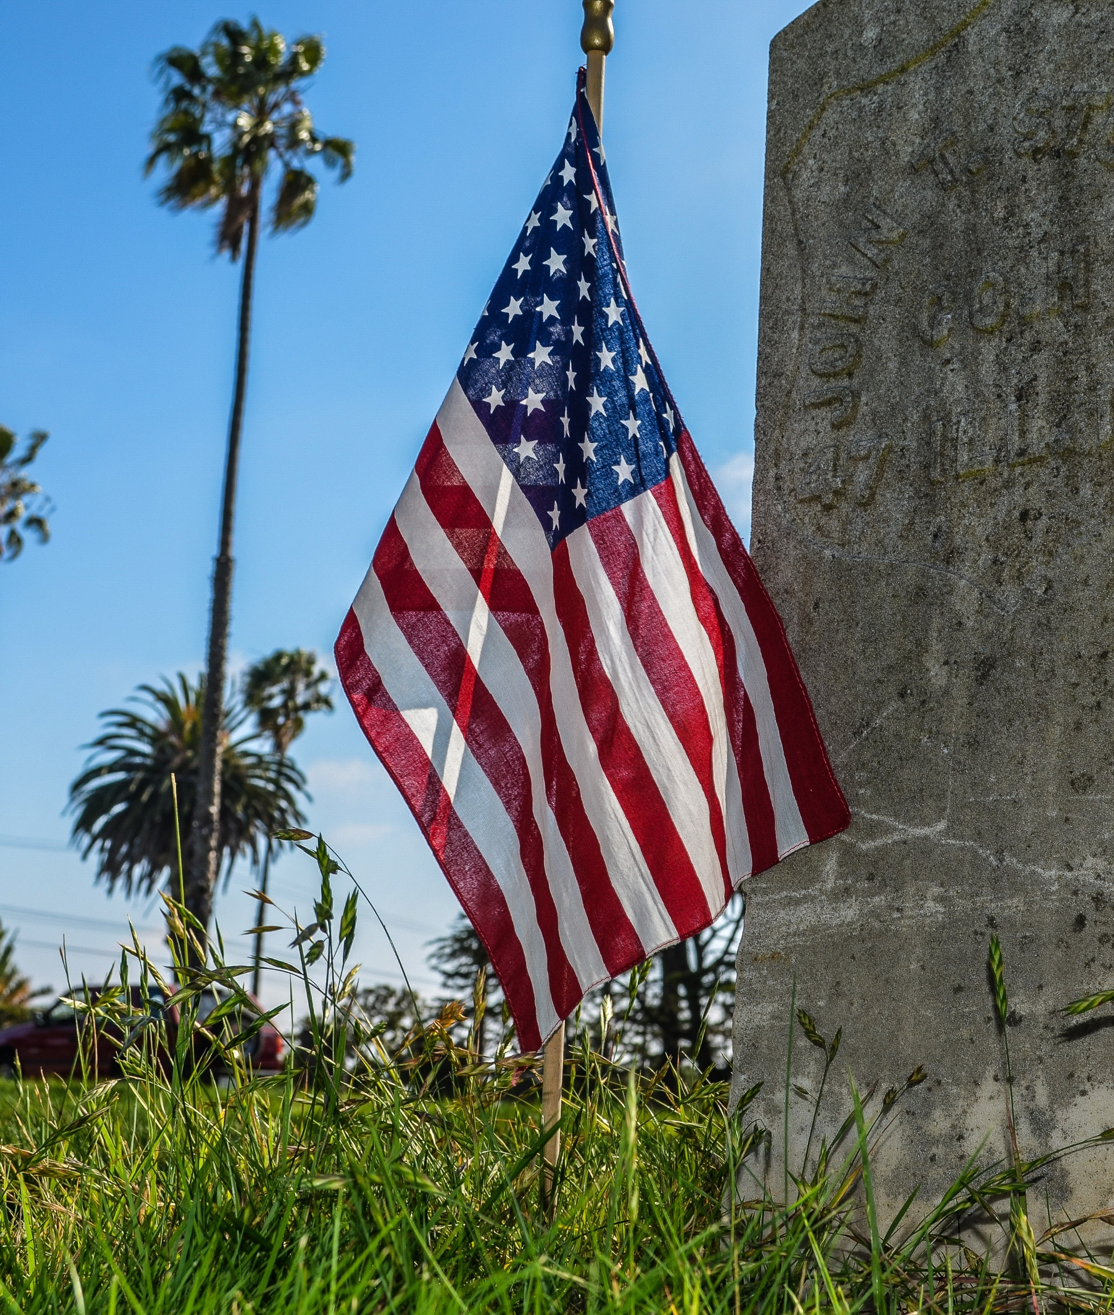
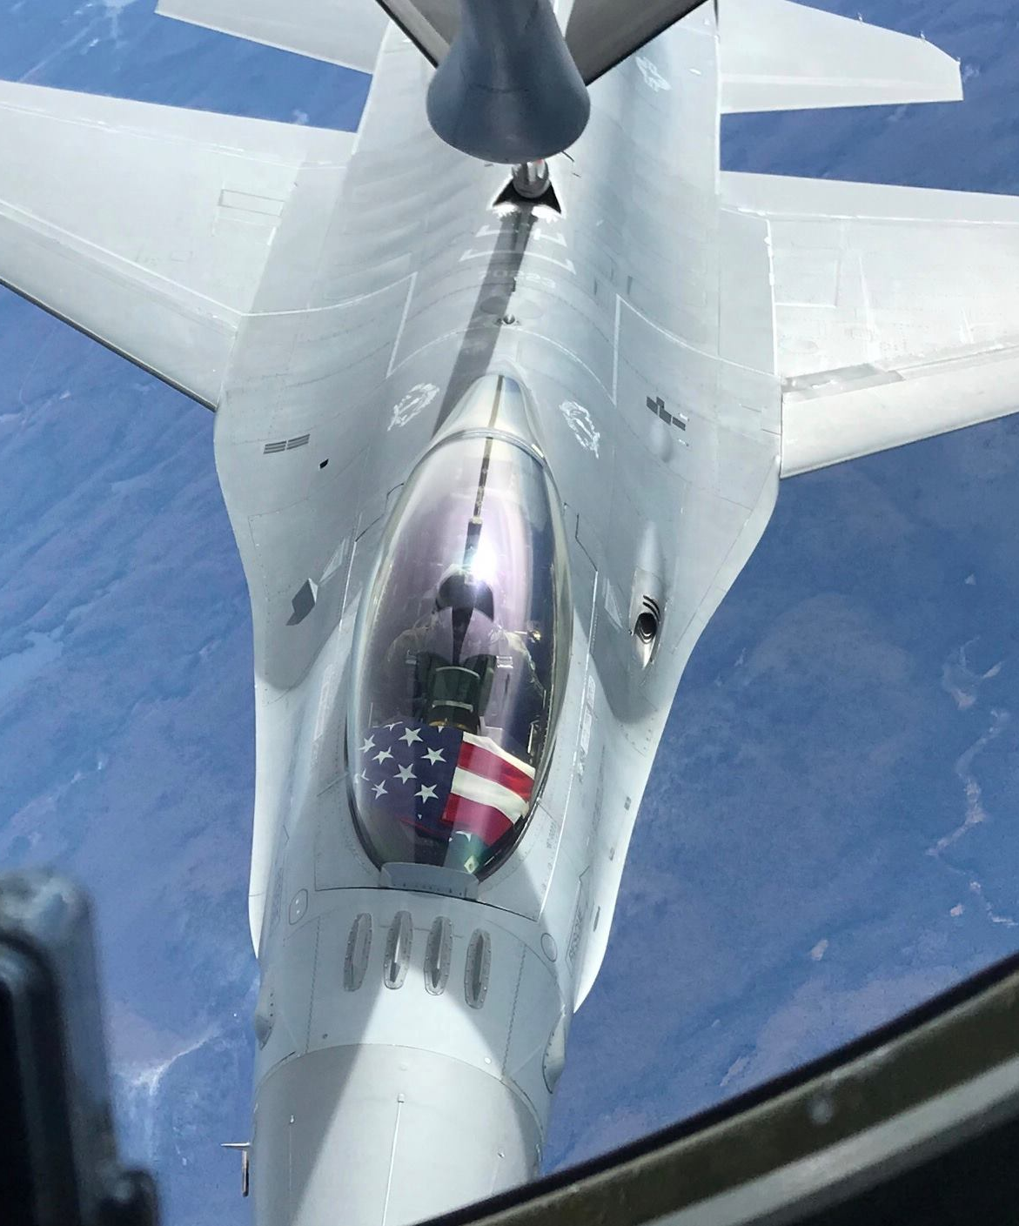

Today, we honor those who served and died for our freedom

Slide 8
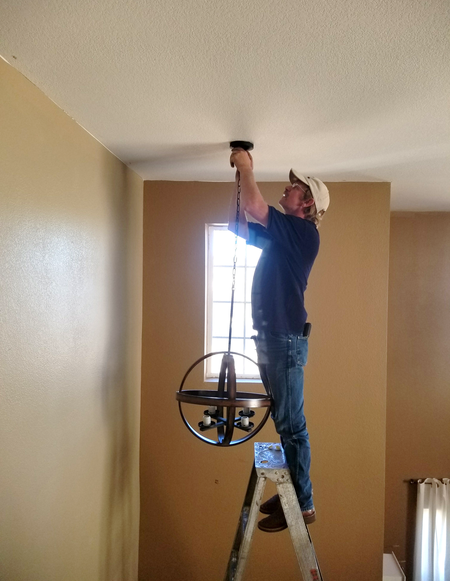
Thank you for lighting our life, Dad!
Happy Father’s Day

Slide 9
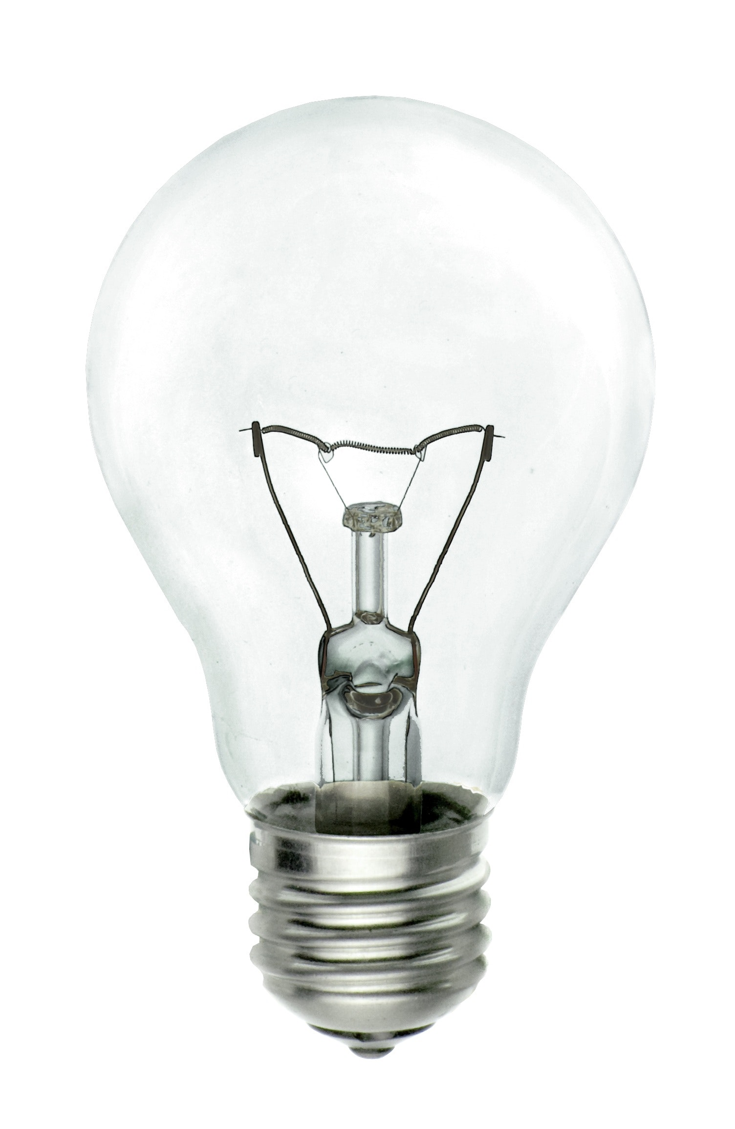
Happy Mother’s Day
What did the mama light bulb say to the baby light bulb?
I love you watts and watts and watts

Slide 10

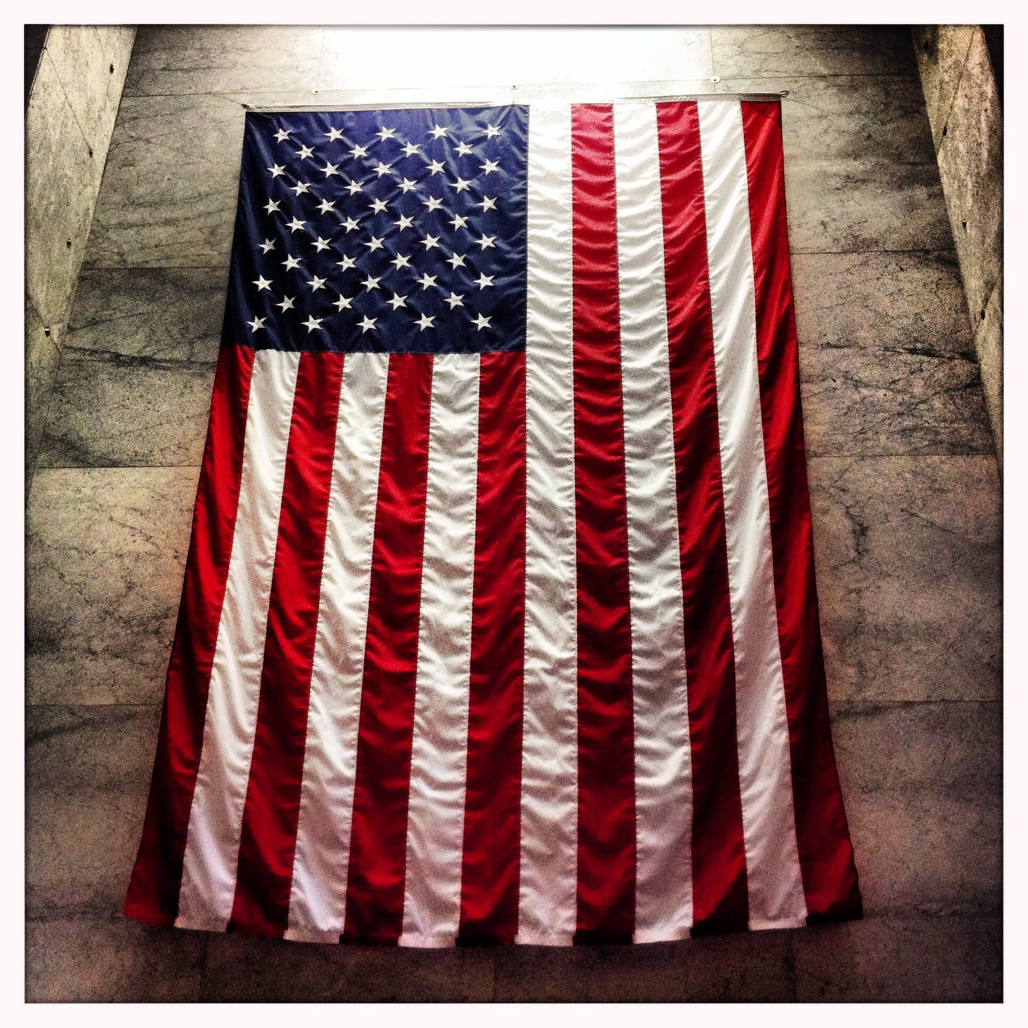


Happy Independence Day

Slide 11
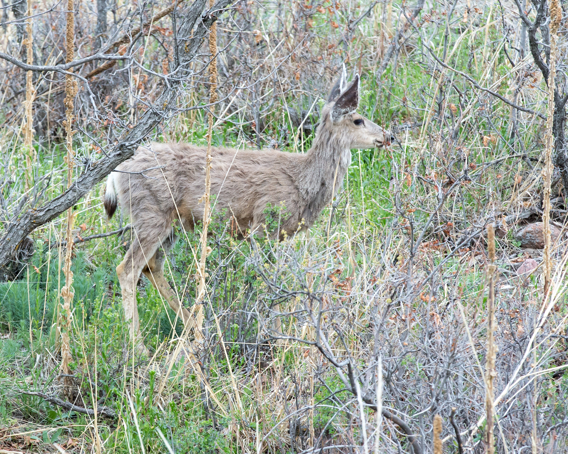

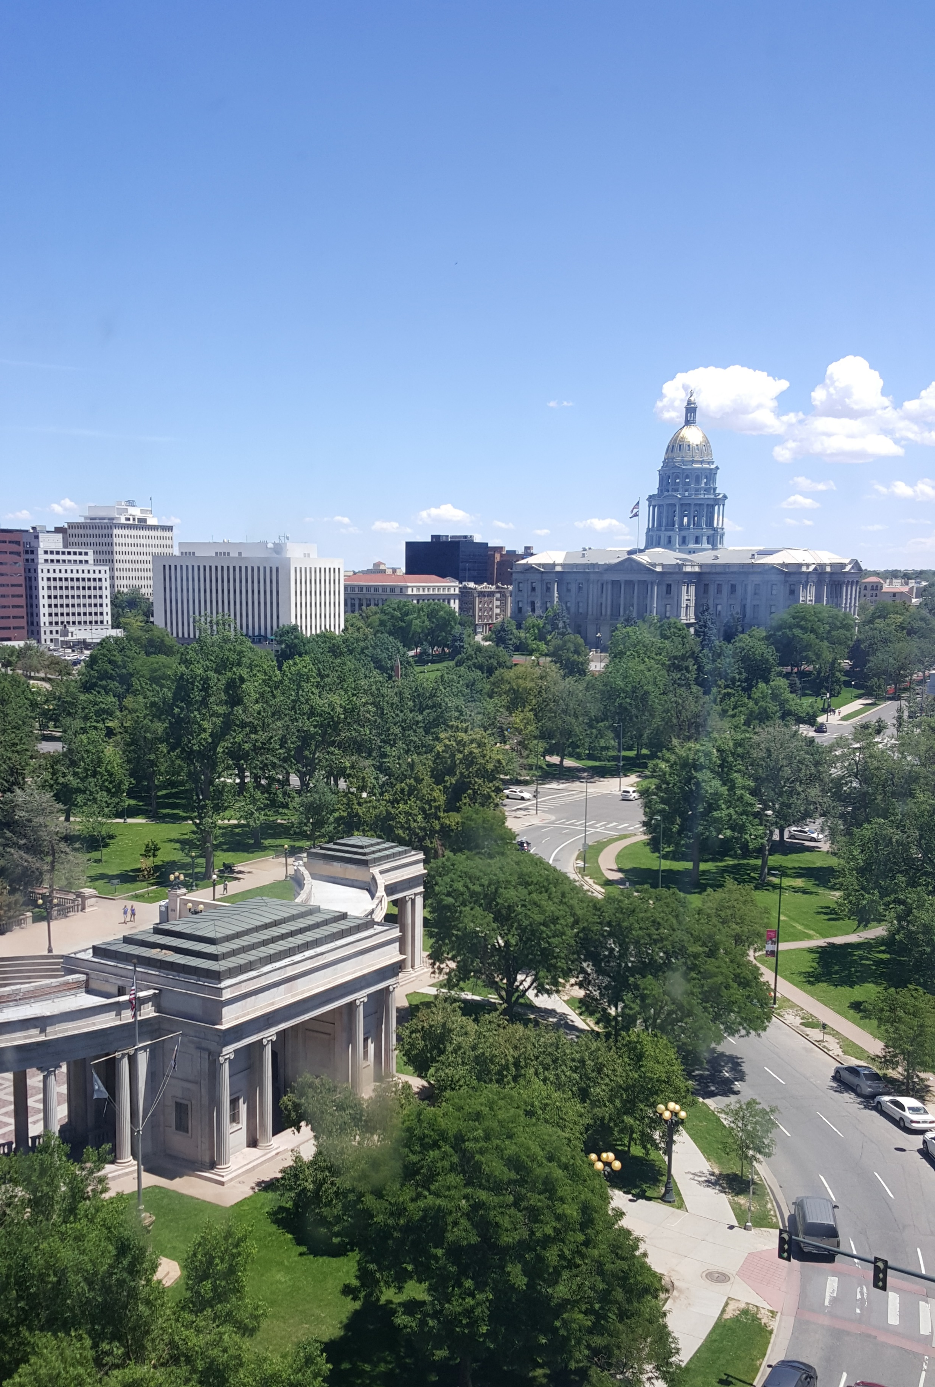

Happy Clorado Day
This Photo by Unknown Author is licensed under CC BY-SA-NC
This Photo by Unknown Author is licensed under CC BY
Notes:
Aug 1

Slide 12
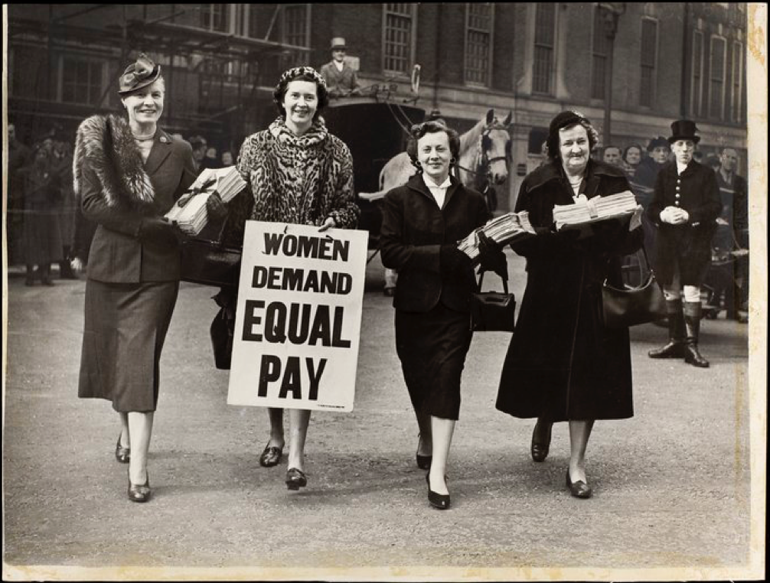

This Photo by Unknown Author is licensed under CC BY-NC-ND
This Photo by Unknown Author is licensed under CC BY-NC-ND
Notes:
August 26th

Slide 13

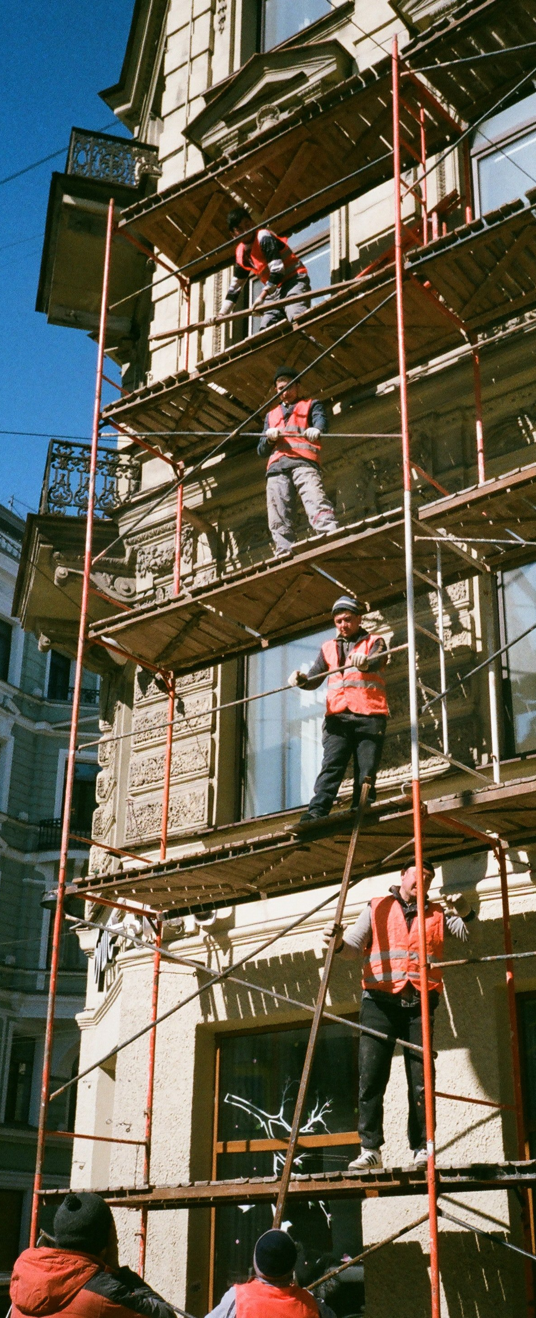




Happy Labor Day

Slide 14

Stay safe and have fun! Happy Halloween!

Slide 15
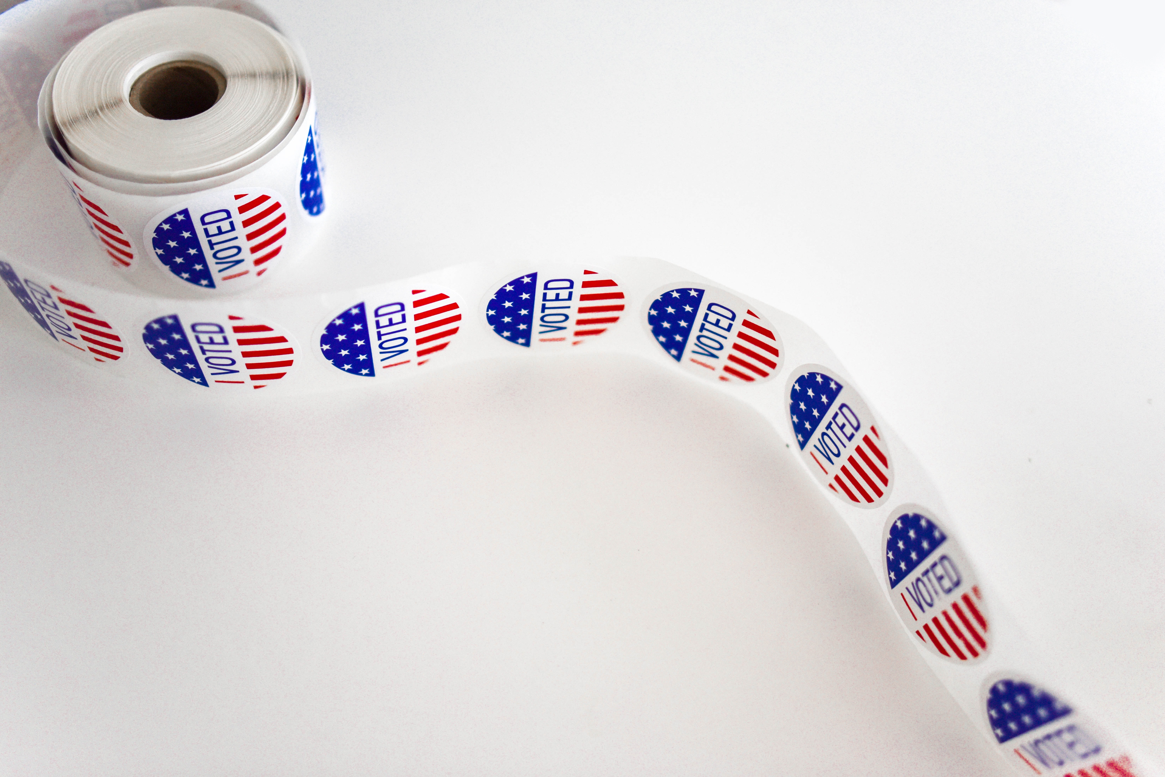
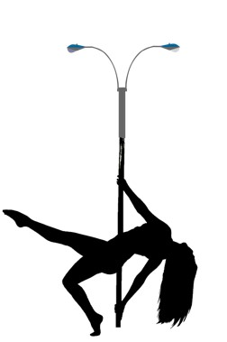

Get Out And Vote!!
We know how to light up the poles!

Slide 16

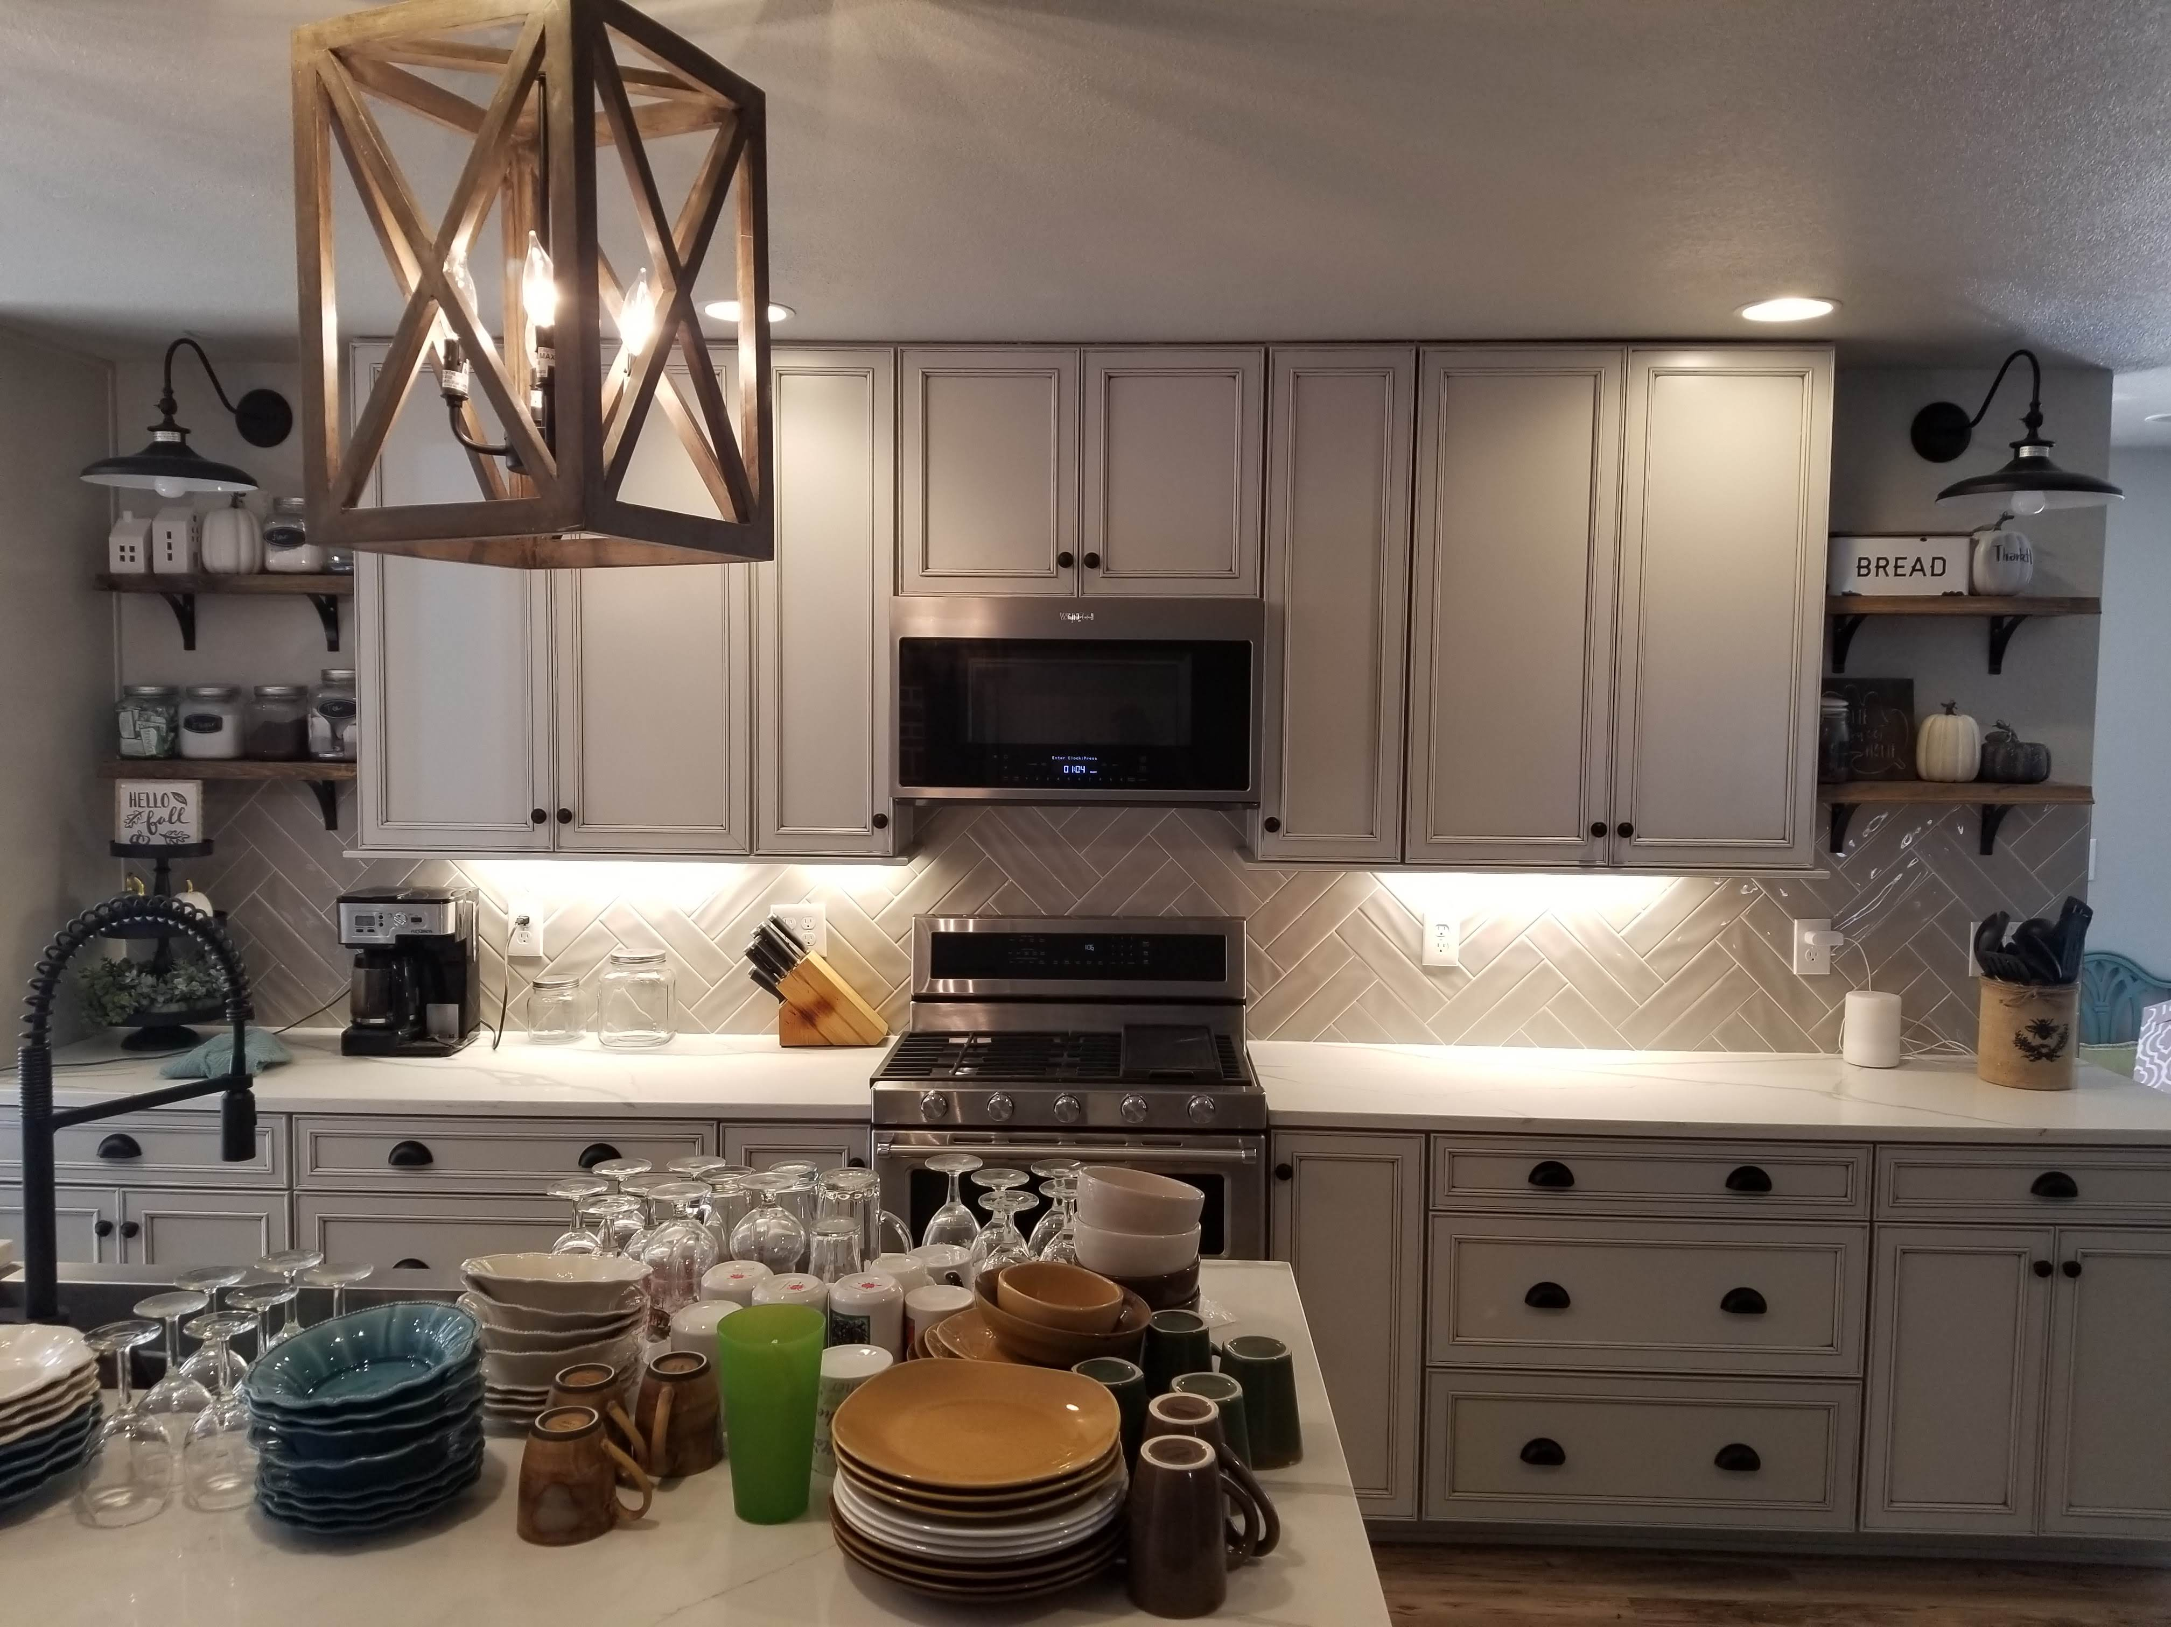
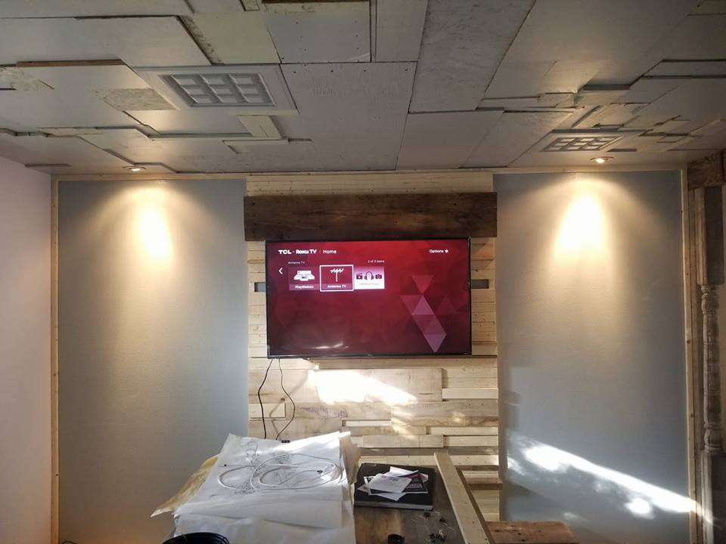
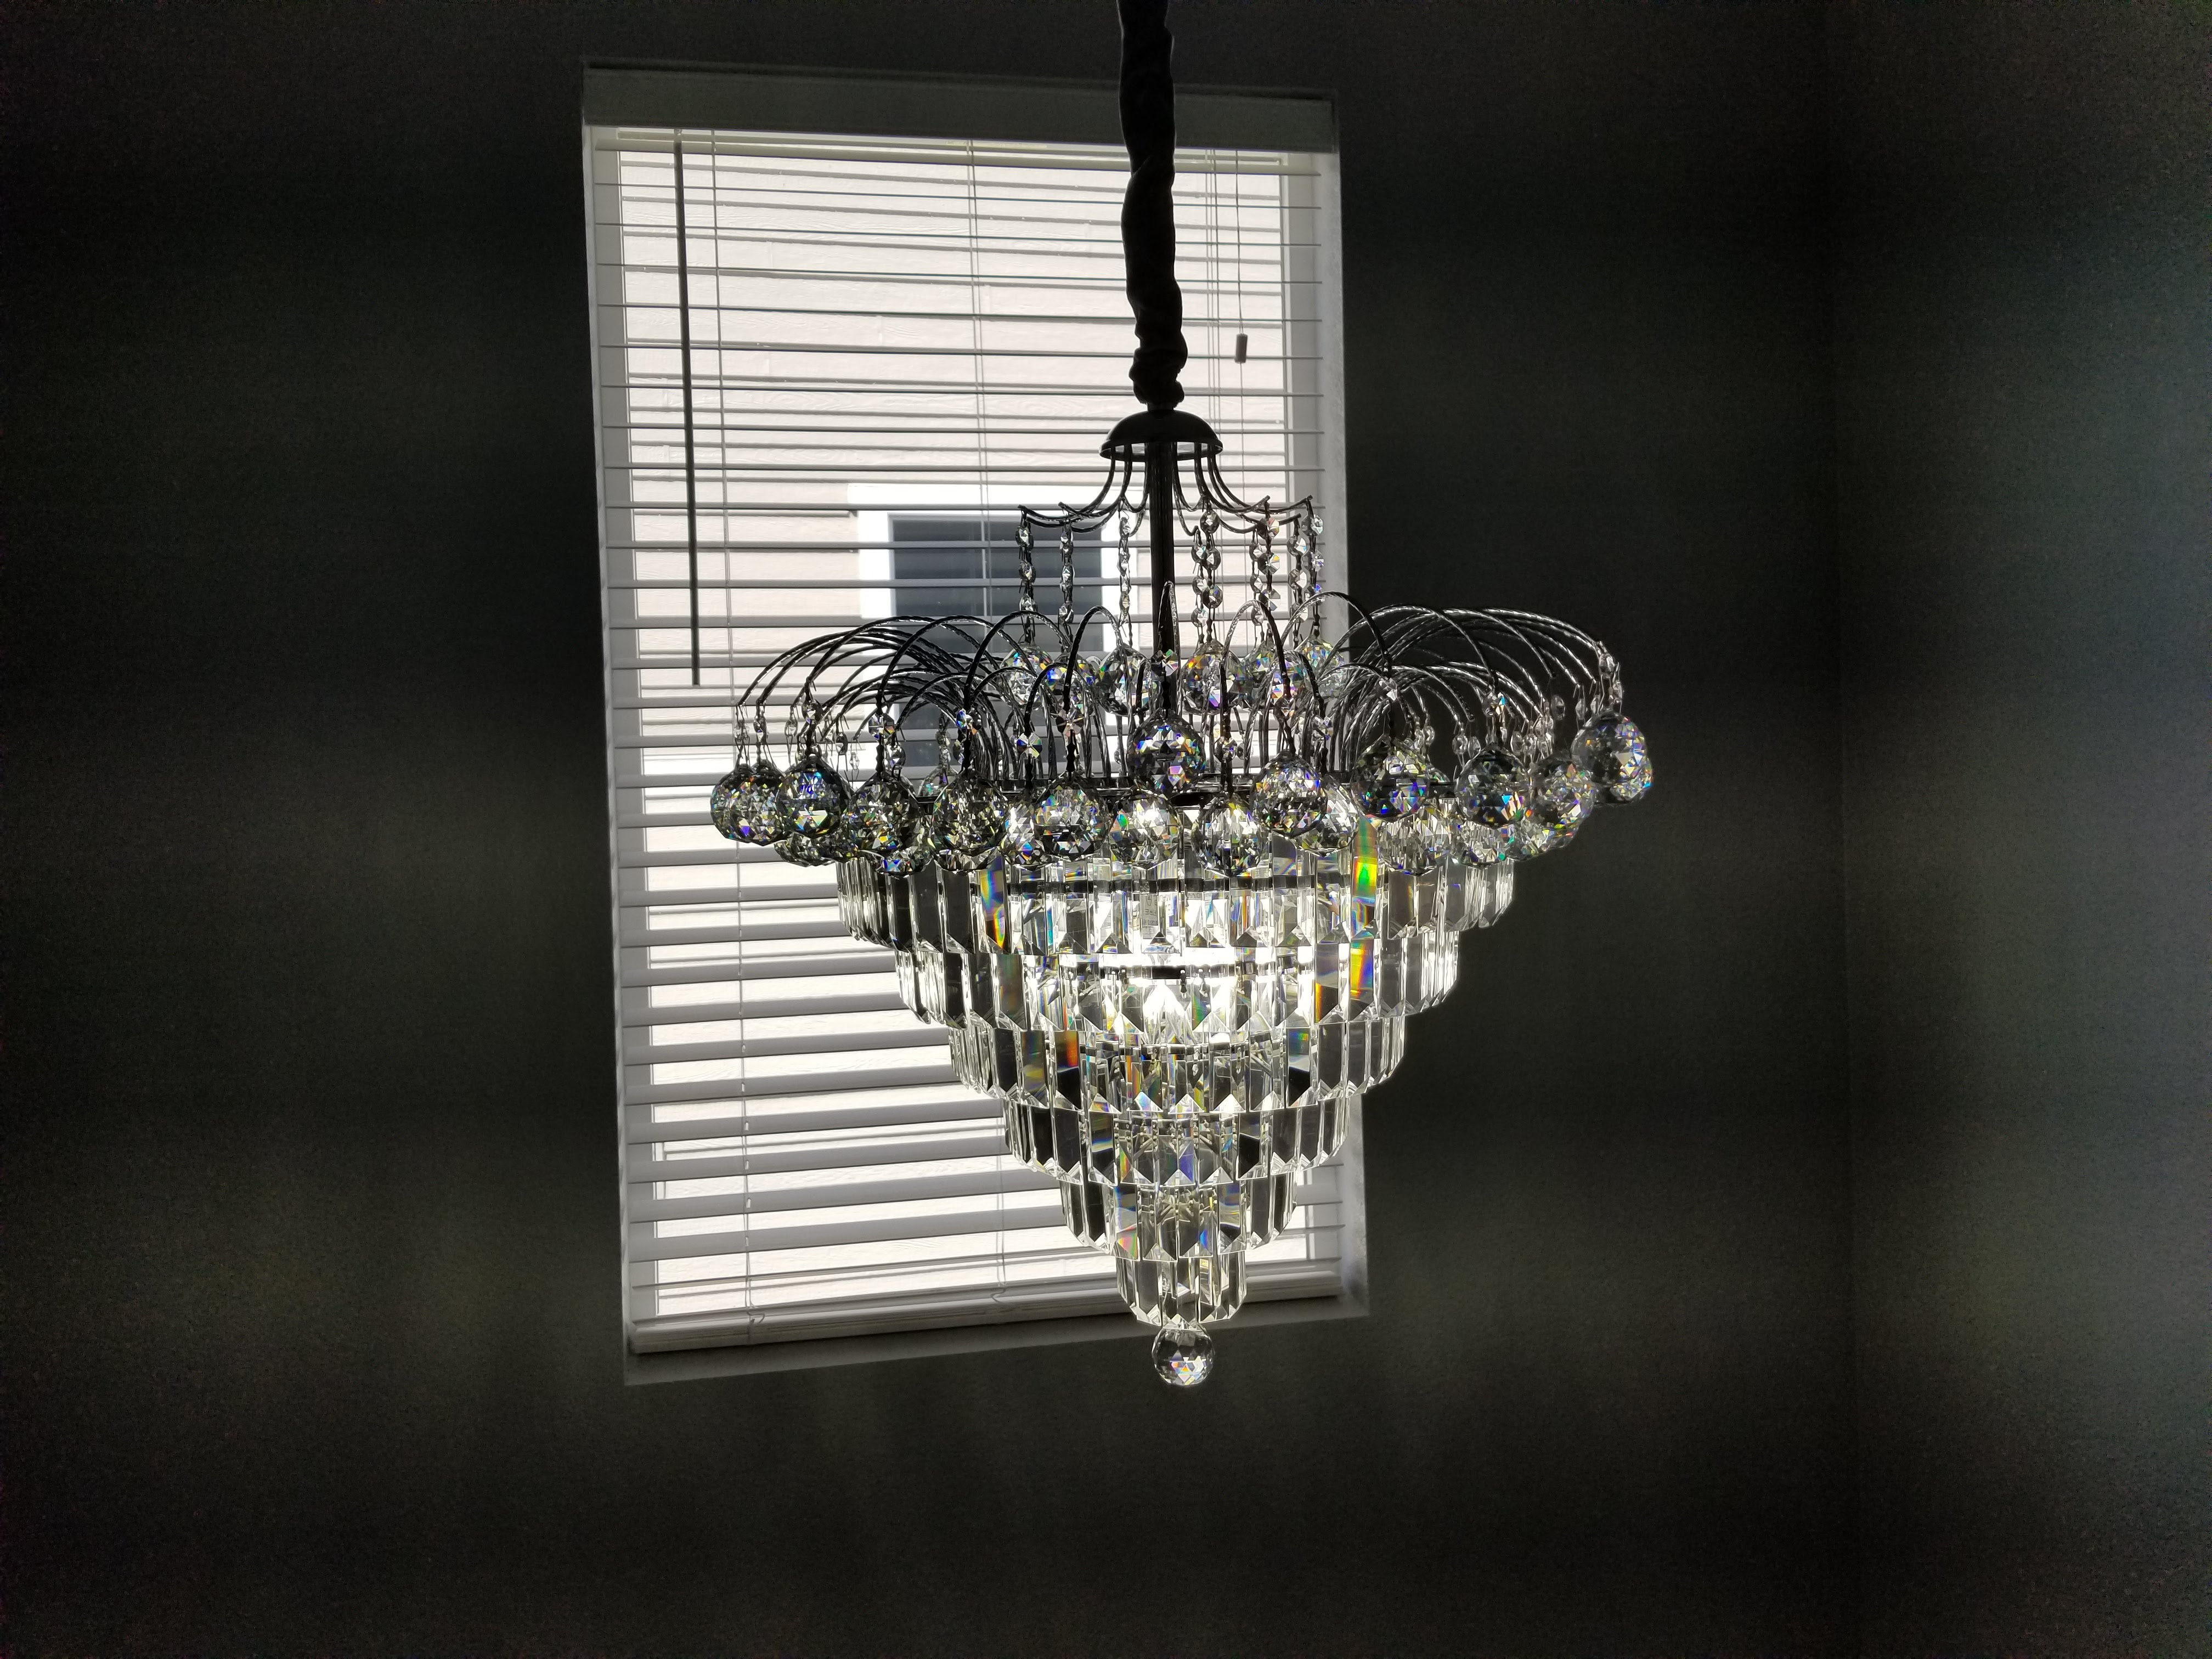
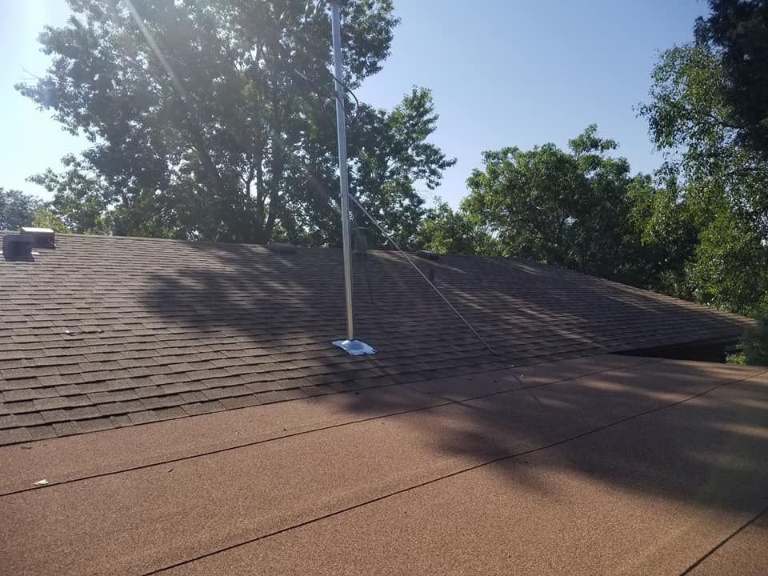
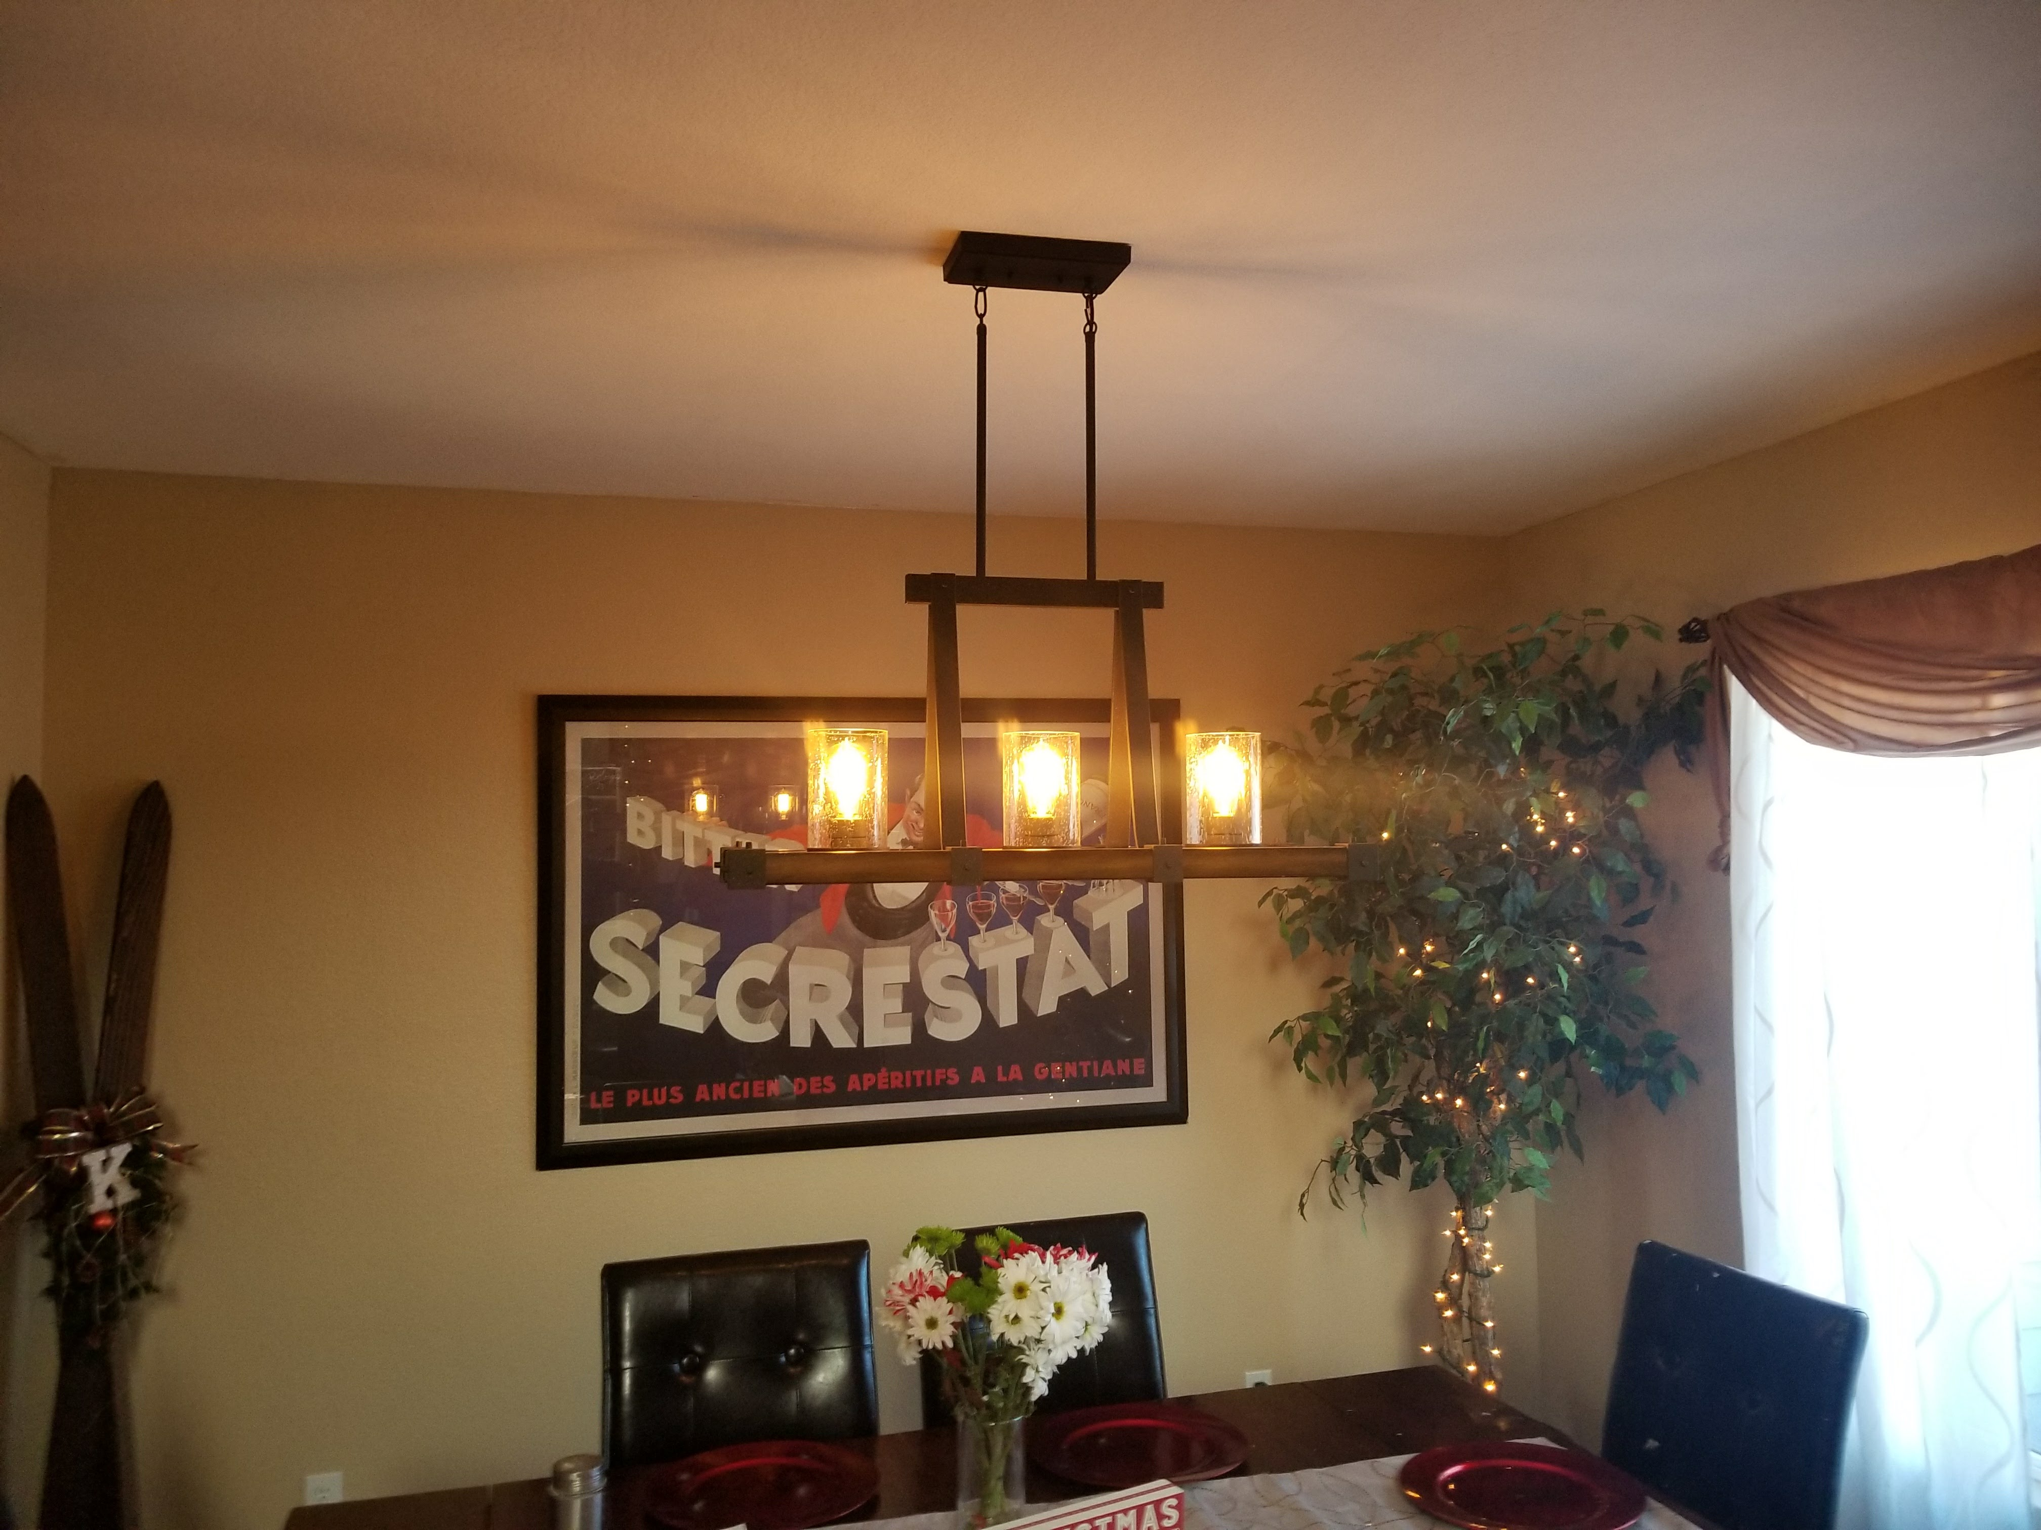
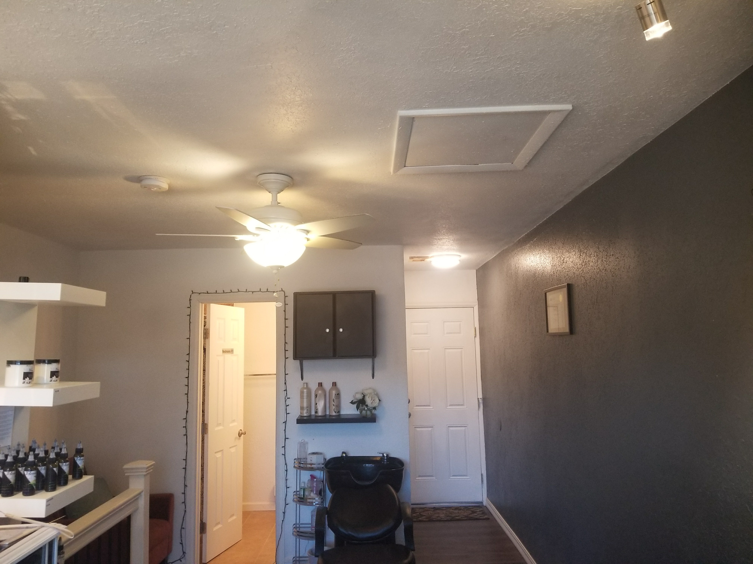
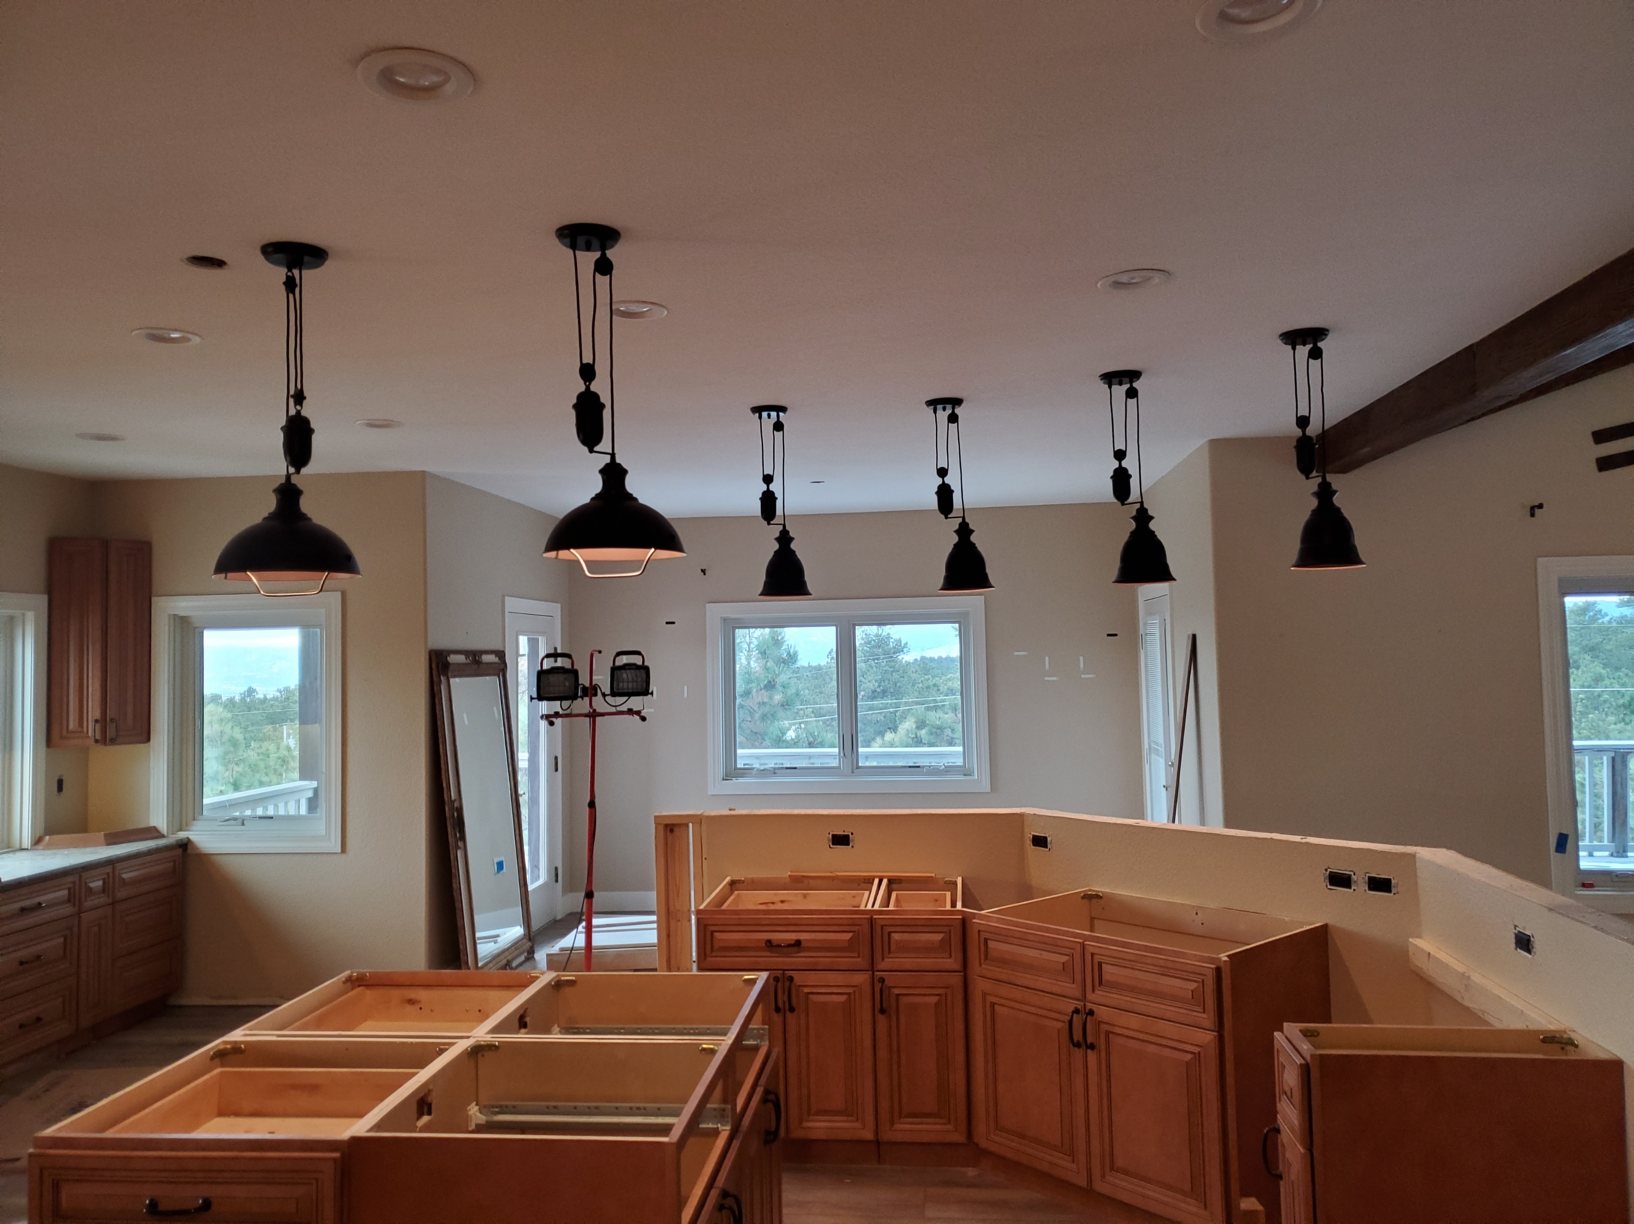
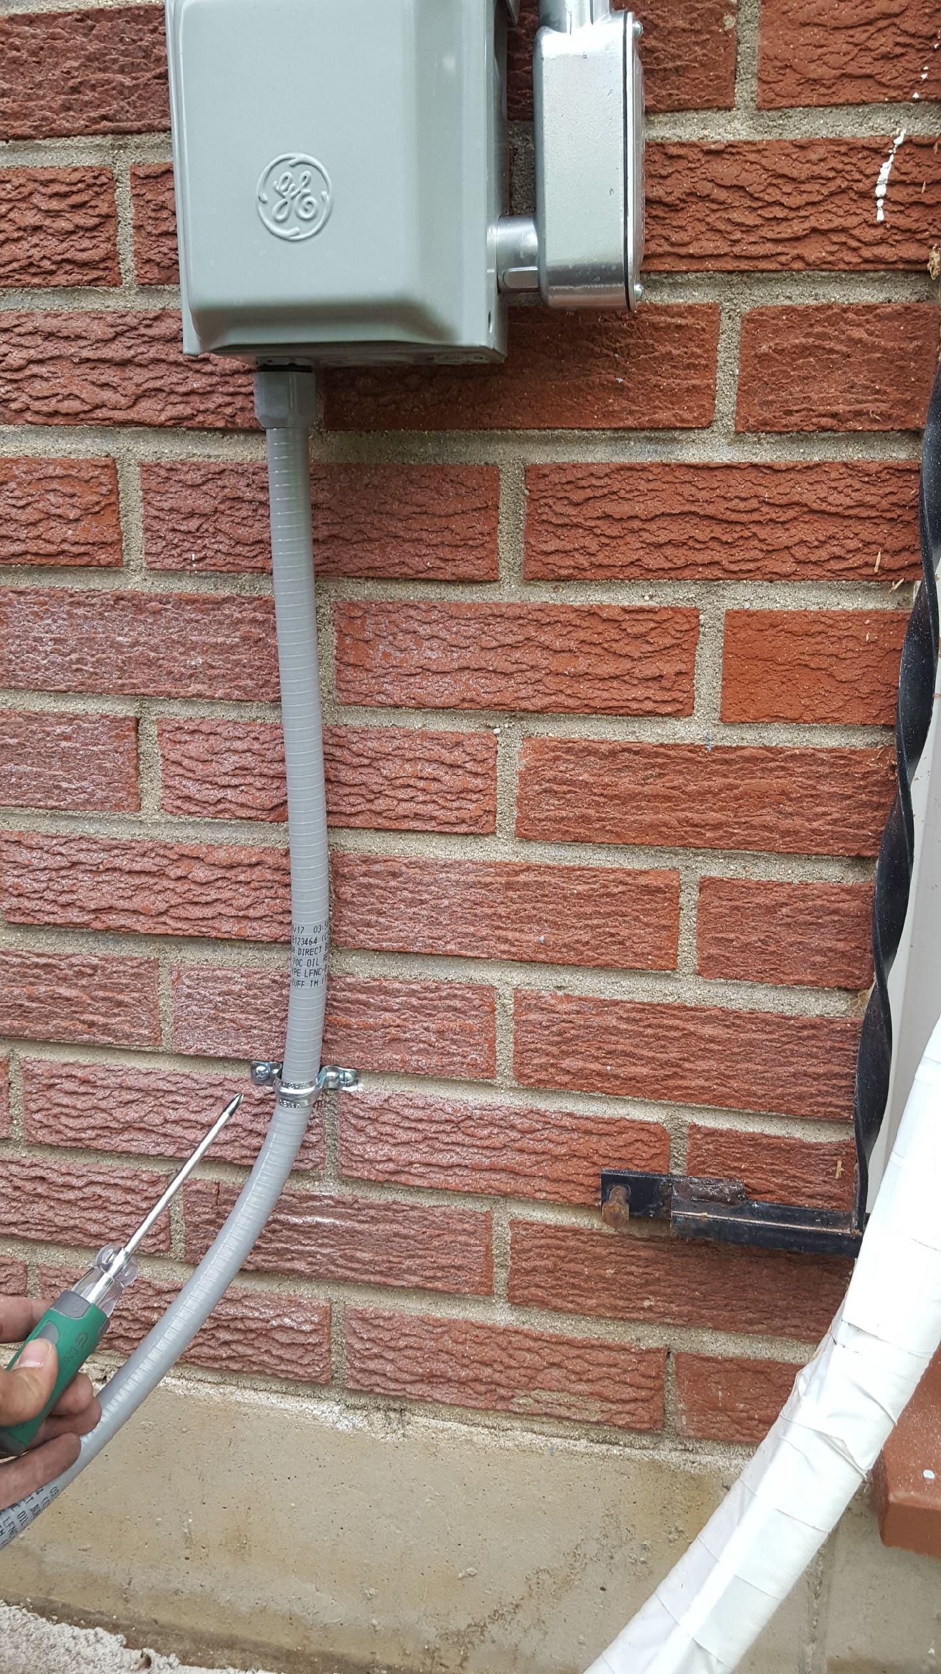
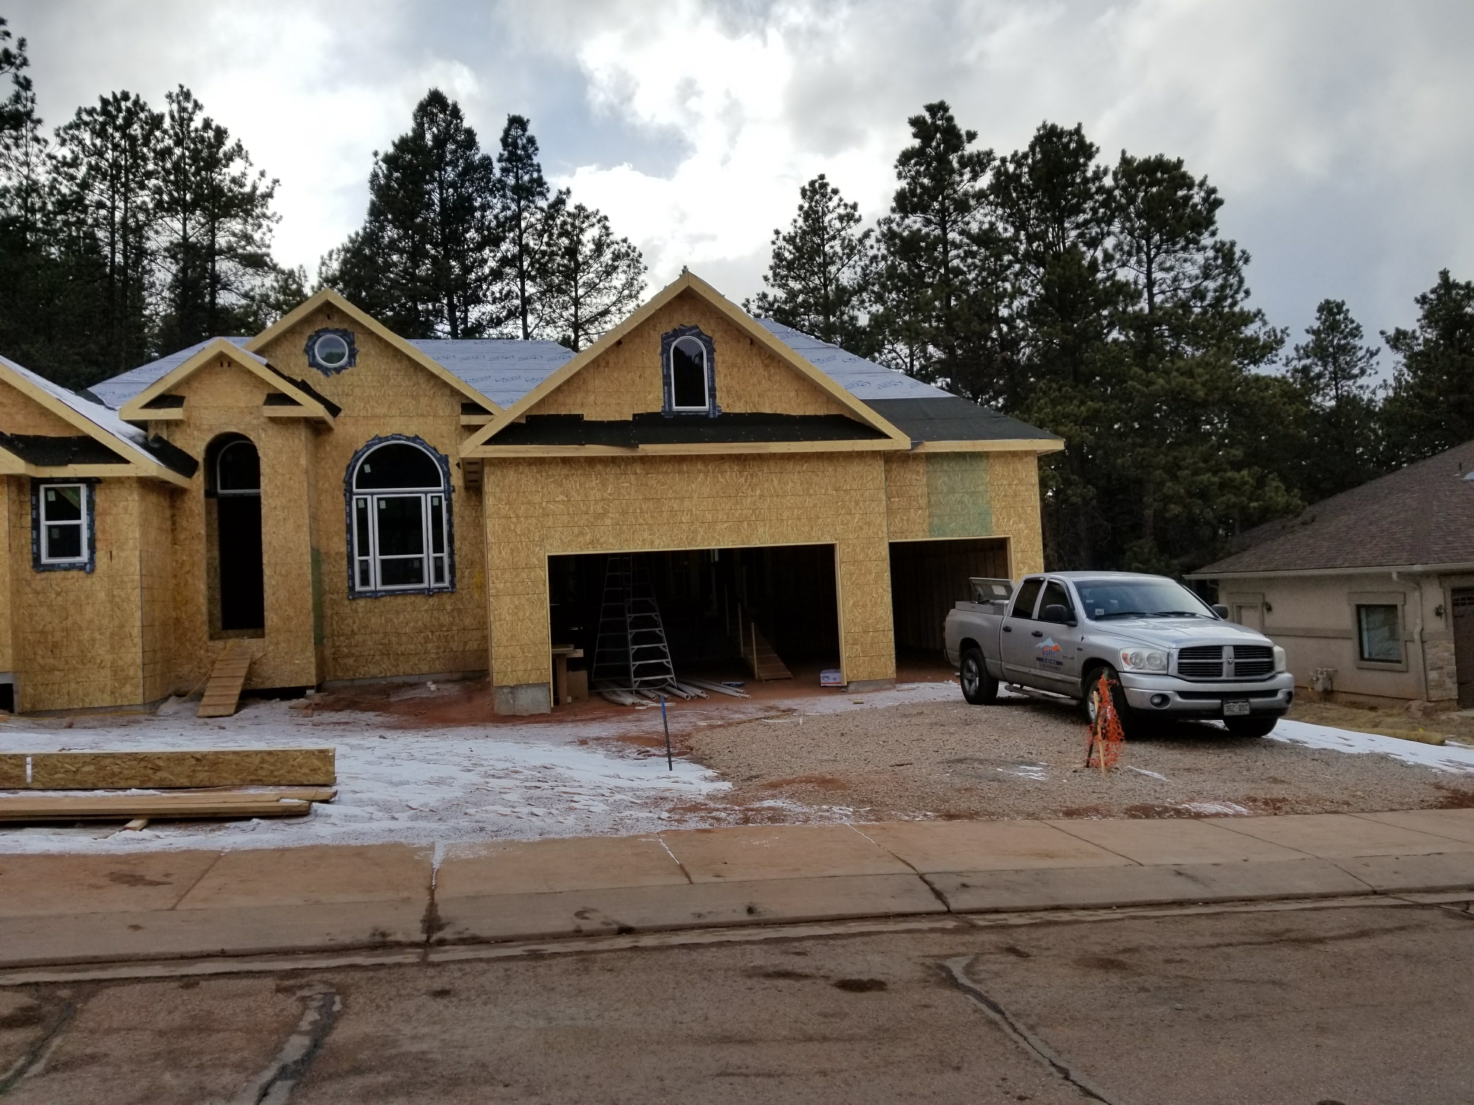
Thank you to our amazing clients! We are so grateful for all y’all!
Happy
Thanksgiving

Slide 17


Merry Christmas to your family From ours

Slide 18

Happy New Year

